Slide 1

F1 Dataset Insights Presentation
-- Group 2
Derek Li
Xinyang Chen
Xuejing Li

Slide 2
Data Preparation
Datasets used: drivers, races, constructors, results.csv
Data preprocessing:
- Create binary variable second_place to indicate 2nd place finish
-Create age_as_of_race through dob column
-Create binary variables for constructorRef with top 5 most wins
-Create binary variables for top 10 grid positions
-Turn milliseconds, fastestLap, rank and fastestLapSpeed into numeric datatype

Slide 3
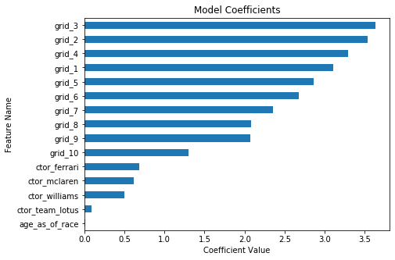
Q1: Second Place Inference
For the Q1 inference model, we used a logistic regression model focusing on starting grid positions and constructors as independent variables.
Based on our model, grid_3 (starting in 3rd position) seemed to be the most important as it had the highest coefficient.

Slide 4
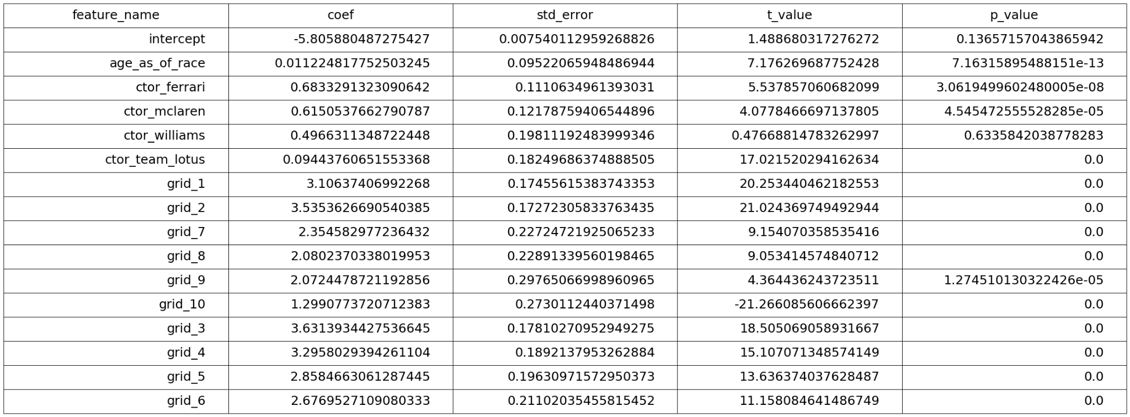
Q1: Second Place Inference
Below is a summary of the model. Most of the grid position variables end up being statistically significant.

Slide 5
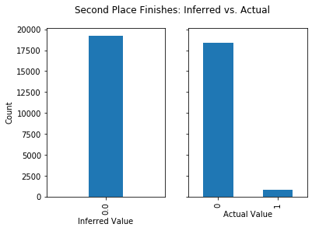
Q1: Second Place Inference
While starting in certain positions or having a certain constructor do seem to result in a higher likelihood of finishing second in a race, the model ultimately ends up predicting no second place finishes for any driver.
This makes sense given the low number of second place finishes in overall data.

Slide 6
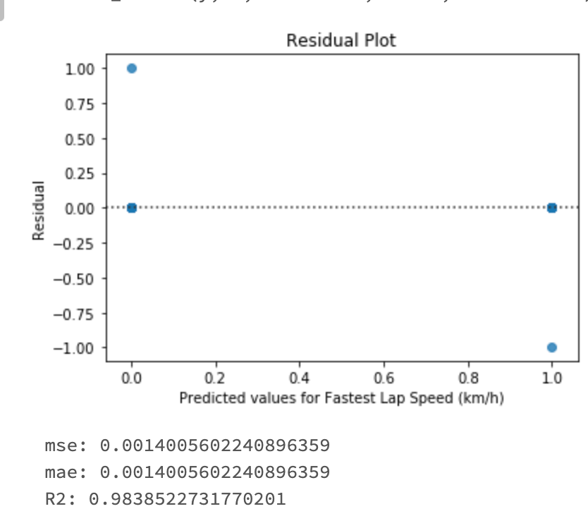
Q2: Second Place Prediction
Prediction Result:
Prediction Process:
Feature selection: drop non-numeric columns
Split dataset into train (1950-2010) and test (2011- ) based on race_year
Fit random forest model
Find model stats (mse), select the best model, and most important feature (“points”)
The model has a mse of 0.0014 and R^2 of 0.984, which means the random forest model is relatively good at predicting the result using the above features.

Slide 7
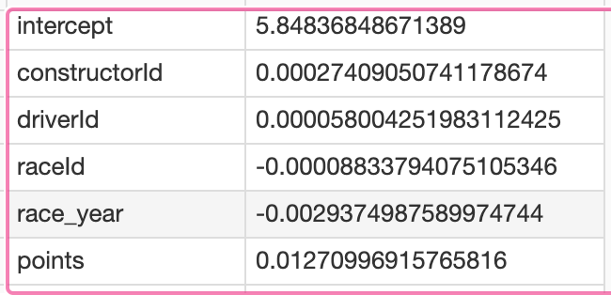
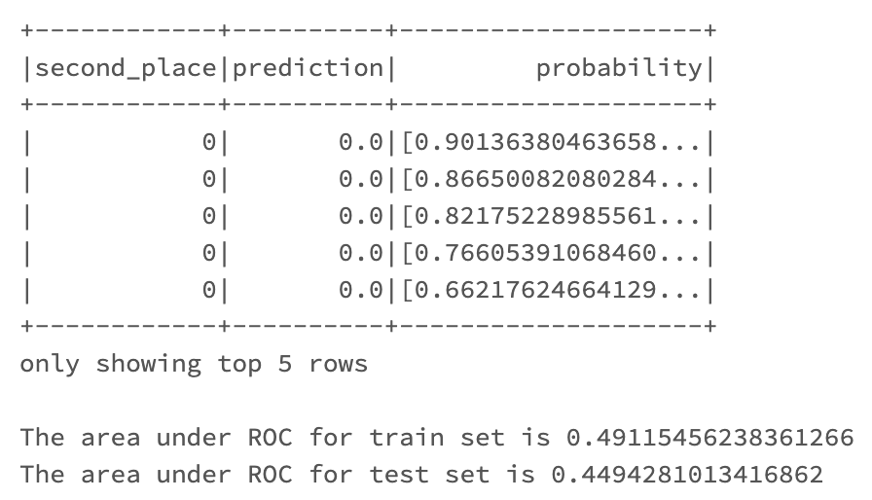
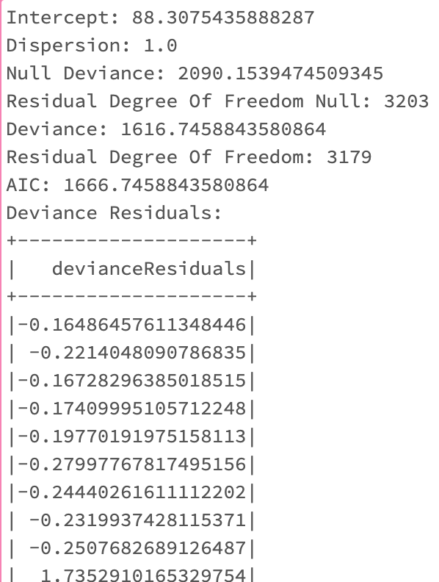
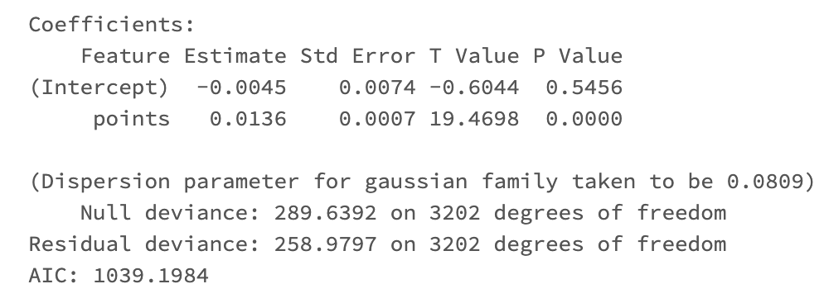
Q2: Second Place Prediction
Feature Validation:
Run logistic regression and generalized logistic regression
Assess metrics e.g. coefficient, p-value, t-value, and R^2
“Points” variable
From the output of “points”, we can see that the variable has a predictive power (0.0136 as coefficient and p-value =0, and ROC is 45%, which has slight discrimination but in general still a reasonably good model.
All variables
From the output of all variables, we see “points’ has a coefficient of 0.0127, and deviance residuals has decreased by added variables. This means that the added variable does have a predictive effect and is a good predictor.

Slide 8
Q3 Inference: Why a constructor wins a season
Building & Selecting Features:
Merge datas that describe features of a race with the status of each race. The status is a binary variable, where if wins equals to 1, the driver wins the race.
Created a season variable to account for the role of seasonality in F1 race by extracting and grouping date of the race. One-hot-encode the four seasons to fit the model.
Created a continent variable to account for constructor’s nationality. This is a continuous variable where 1,2,3, and 4 each means if the constructor is from Europe, North and South America, Asia, and Africa.
Grouped by year and constructor ID and Calculated the average of each explanatory variable for every constructor in every year between 1950 and 2010.

Slide 9
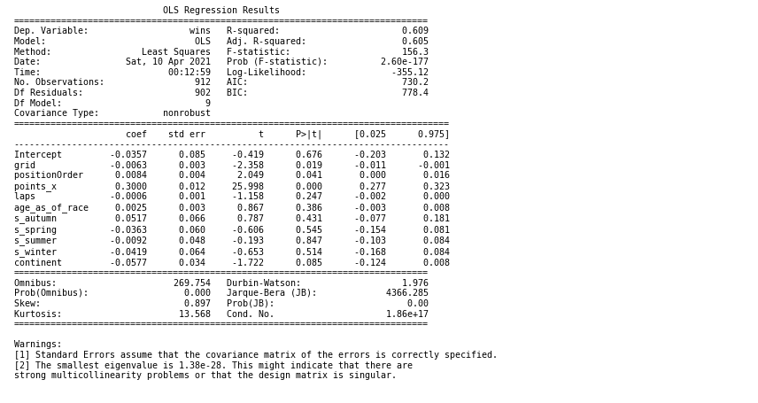
Q3 Inference: Why a constructor wins a season
R-squared is 0.609, indicating the logistic regression accounts for 61% of the variance. The model fits the data somewhat well.
Grid, PositionOrder, and points are all statistically significant features. Points has the highest coefficient, which makes sense given it is used to determine the outcome of both the Drivers’ and Constructor’s World Championships. Each season, the Championship is awarded to the driver and the team that have scored the highest number of points.
Interpretation: Holding all other variables at fixed values, we will see a 30% increase in the odds of the constructor winning the season for every extra point the constructor earns. Points are awarded based on the position the driver finishes at.

